Slide 1
Minnesota Election
Landon, Ali, Kyle, Nick
Notes:
Nick

Slide 2
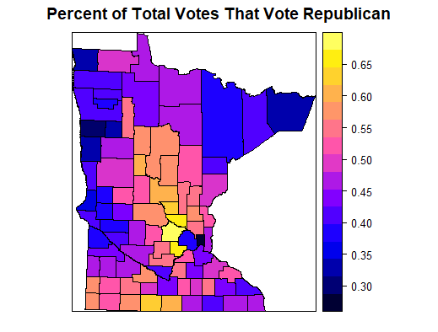
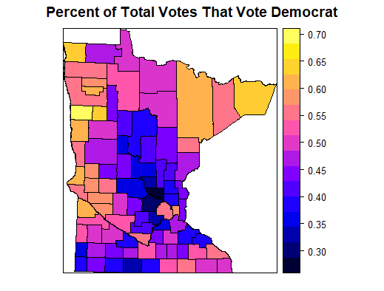
Exploratory Analysis - Votes
Notes:
Landon
Higher republican in suburbs
Surprising results on western side of Minnesota
Expected to be republican, look more like SD and ND
Note where there is > 55 and < 40 percent of votes for each

Slide 3
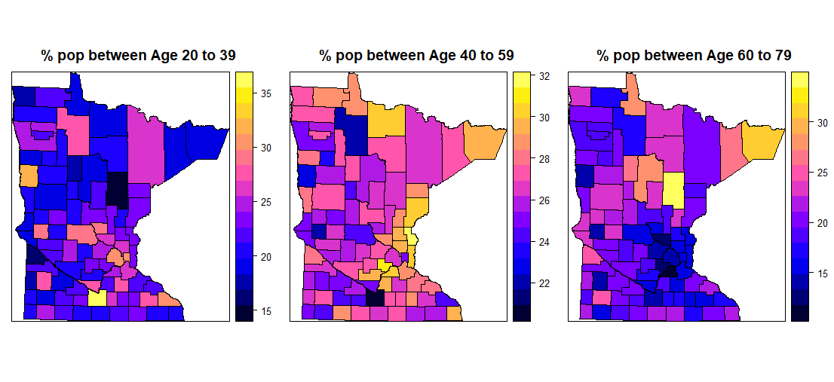
Exploratory Analysis - Age
Notes:
Kyle
Younger people more concentrated in the cities
40-59 are highly represented in suburbs
Older people in more rural areas
Anomalies represent college town

Slide 4
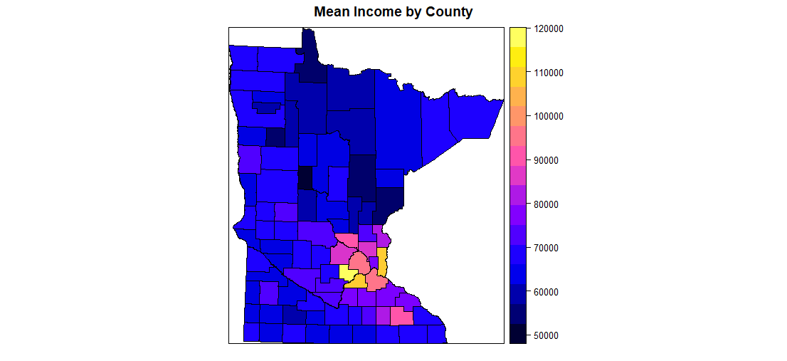
Income
Notes:
Ali
Higher income near cities b/c of higher job opportunity and higher pay
Anomaly in southeast corner due to Rochester

Slide 5
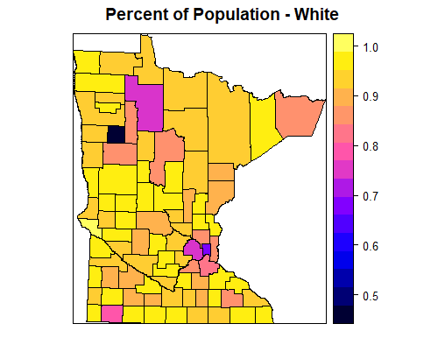
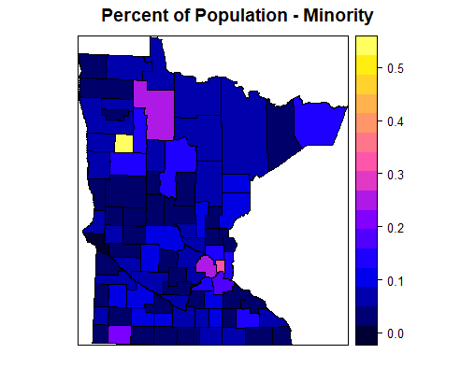
Exploratory Analysis - Race
Notes:
Ali
Higher populations of minorities near city
North west anomaly is reservation

Slide 6
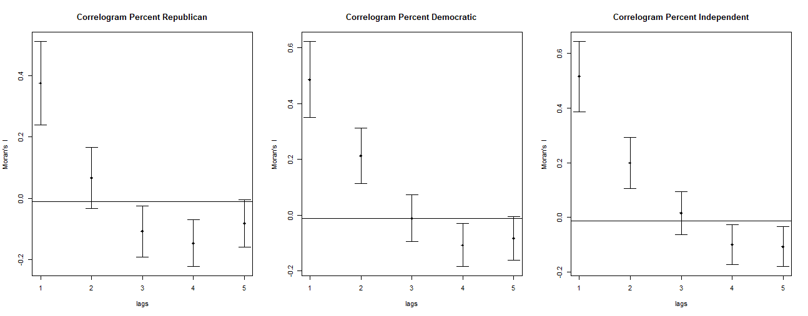
Autocorrelation Analysis – Global Moran’s I
Notes:
Nick
Two lag autocorrelation indicates “clustering” of counties instead of just pairwise autocorrelation
Republican autocorrelation not significant at lag distance 2

Slide 7
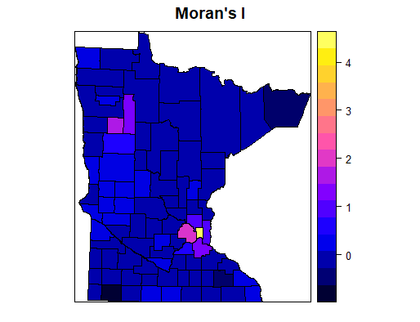
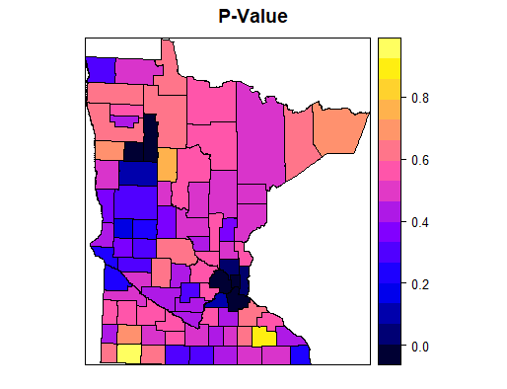
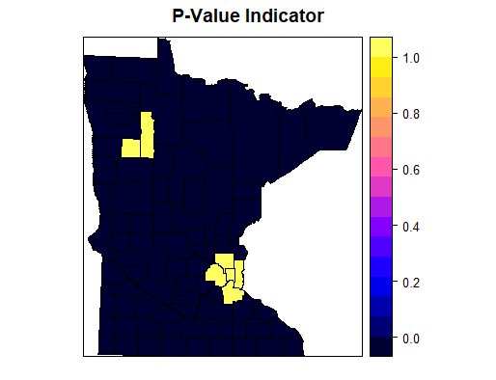
Local Moran’s I – Percent White

Slide 8
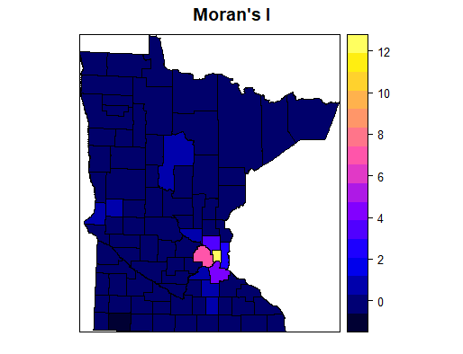
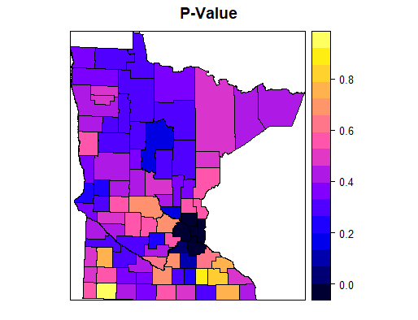
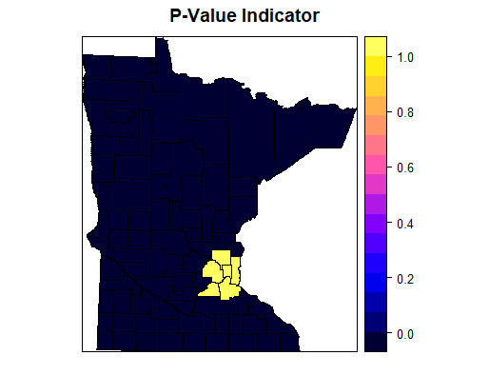
Local Moran’s I – Percent Black

Slide 9
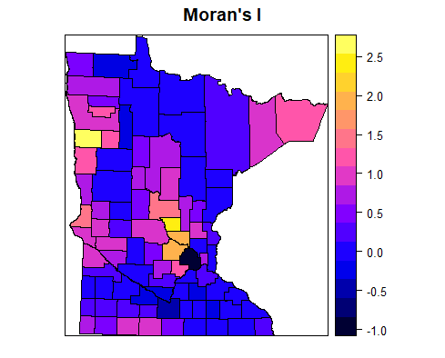
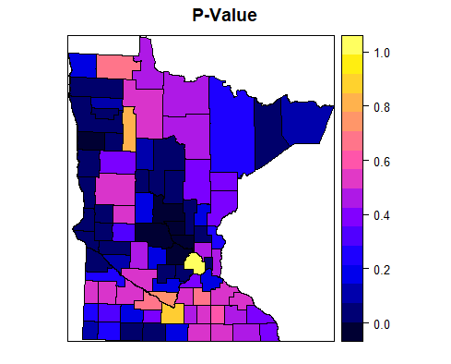
Local Moran’s I – Republican
Notes:
Landon
Bright colors on left mean higher Moran’s I
Dark colors on right mean lower p-value, higher chance to reject null hypothesis

Slide 10
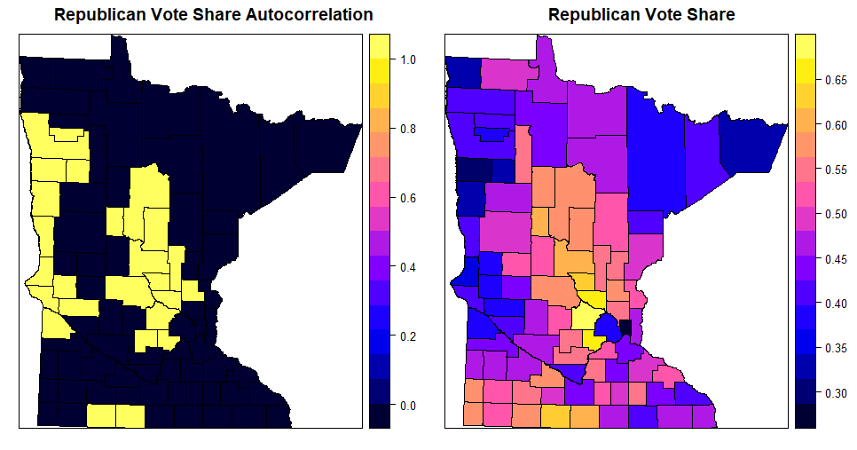
Republican
Notes:
Landon
Yellow means statistically significant positive spatial autocorrelation
Relationship between autocorrelation and counties that either did really good or really bad

Slide 11
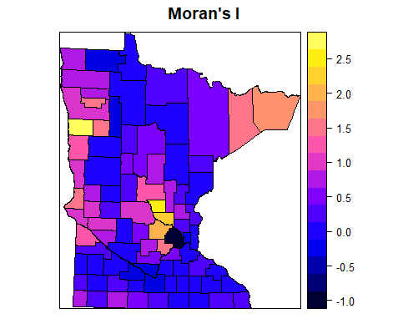
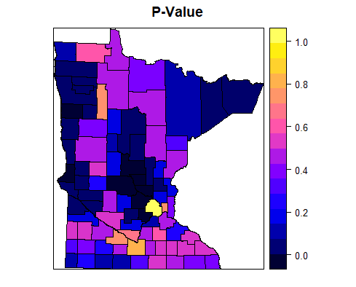
Local Moran’s I – Democratic
Notes:
Kyle
Bright colors on left mean higher Moran’s I
Dark colors on right mean lower p-value, higher chance to reject null hypothesis

Slide 12
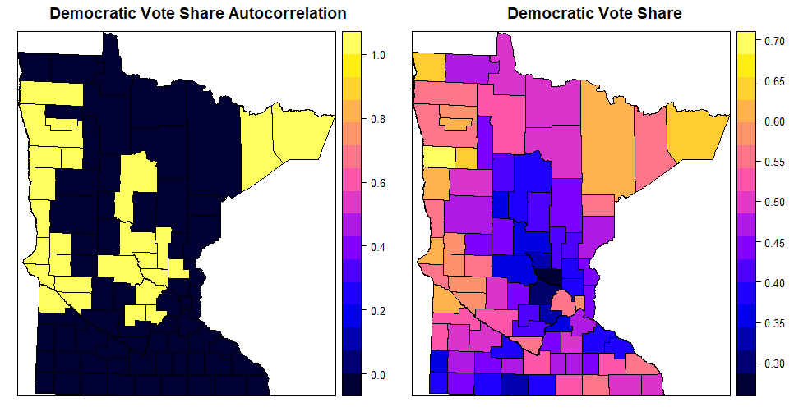
Democratic
Notes:
Kyle
Yellow means statistically significant positive spatial autocorrelation
Relationship between autocorrelation and counties that either did really good or really bad

Slide 13
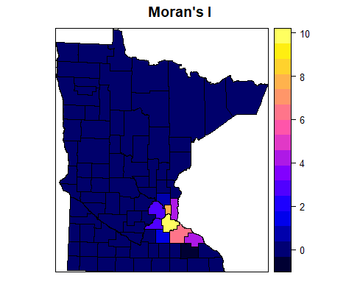
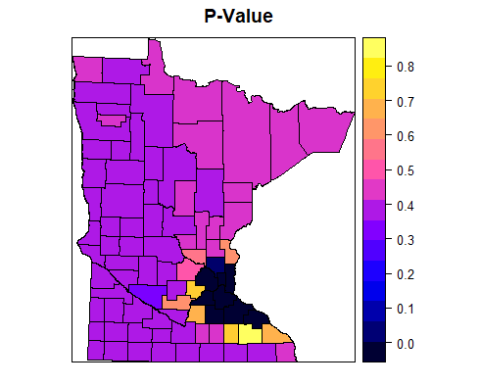
Local Moran’s I – Independent
Notes:
Ali
Bright colors on left mean higher Moran’s I
Dark colors on right mean lower p-value, higher chance to reject null hypothesis

Slide 14
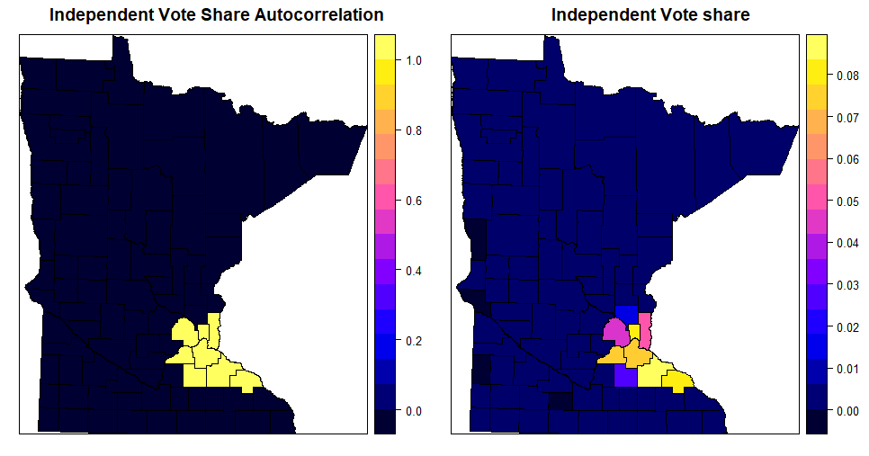
Independent
Notes:
Ali
Yellow means statistically significant positive spatial autocorrelation
Relationship between autocorrelation and counties that either did really good or really bad

Slide 15
Conclusion
Electoral strategy to determine where to campaign
Future research could look at predicting party vote share by county
Questions?
Notes:
Nick

